Slide 1


Capstone Project 4 - Part 2
Group 11: Section 001
Student Name | Student ID
Arjunkumar Kantilal Kori | 0851146
Fawwaz Mohammed Akram | 0856436
Gunjan Sharma | 0845467
Sanjaysinh Rajendrasinh Chavada | 0844918

Slide 2

“Precision You Can Wear, Luxury You Can Feel.”

Slide 3
Mission Statement
Our mission is to bring the unmatched precision and luxury of Swiss watches to customers in Canada. We achieve this through careful sourcing of high-quality watches, ensuring they are transported securely and are packaged elegantly. We also focus on fast delivery to make sure our customers receive their luxury timepieces quickly and safely.

Slide 4

Product Overview
Swiss Crafters is a Canadian retailer of luxury Swiss watches.
Sourced from: Swatch Group (Switzerland)
Available at: Retail store, 123 Rue Sainte-Catherine, Montreal
Key Features:
They have COSC-certified movements, which means the watches are officially tested and proven to be extremely accurate.
They use sapphire crystal (a very hard, scratch-resistant glass) and stainless steel (a strong, rust-resistant metal).
Each watch comes in branded packaging and includes proof of authenticity, so you know you're getting a real Swiss watch.

Slide 5

Watches Brands & Models
We offer:
Omega Seamaster – 200 units
Longines Master – 200 units
Tissot PRX – 500 units
Hamilton Khaki – 500 units
Swatch Sistem51 – 100 units
Target Market
Professionals
Collectors
Fashion-conscious buyers
Gift shoppers

Slide 6

Price Range
Swatch Sistem51: Starts at $650 CAD – a great option for those looking for a high-quality watch at a lower price.
Tissot, Hamilton, Longines: Mid-range prices – offering excellent value for luxury watches.
Omega Seamaster: Can go up to $12,000 CAD – a top-tier, premium choice for serious watch lovers.
These watches provide affordable luxury for different budgets, making them perfect for a wide range of Canadian buyers.

Slide 7
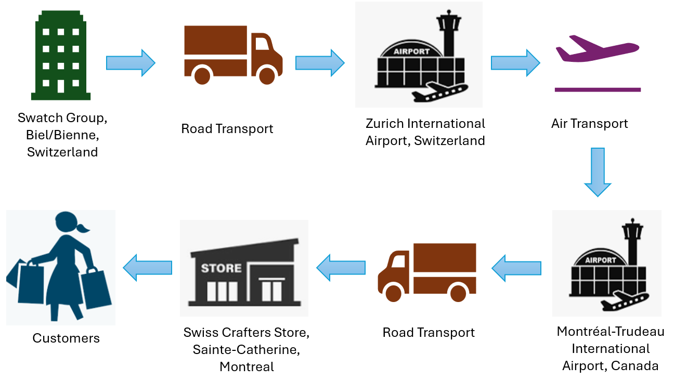
Supply Chain Overview

Slide 8

Sourcing and Procurement
Supplier: The watches come from the Swatch Group, a well-known company in Switzerland.
Order Quantity: 1,500 units (watches) are being ordered.
Payment Terms: You’ll pay 50% upfront when placing the order and the remaining 50% before the shipment is sent.
Documents: You’ll receive a warranty, certificates, and the original packaging with each watch.
Lead Time: The watches will be ready to ship in 1 week after the order is confirmed.

Slide 9
Air Freight (Zurich → Montreal): The watches will be flown from Zurich (Switzerland) to Montreal quickly and safely.
Truck (Montreal → Windsor): After arriving in Montreal, the watches will be delivered by truck to Windsor in an efficient way.
Benefits: This shipping method reduces the chance of theft or damage and ensures the watches arrive on time.
Preferred Transportation

Slide 10

Packaging
Each watch box is 10x10x10 cm and weighs 0.5 kg.
Packaging Levels:
Primary Packaging: Each watch comes in a foam-padded branded box to protect it.
Secondary Packaging: The watches are grouped in 10 boxes per carton, and there will be a total of 150 cartons.
Tertiary Packaging: All the cartons are packed onto shrink-wrapped pallets for easier shipping and handling.

Slide 11
Issues and Solutions
Delay in Packing: There was a 1-day delay in packing the watches, but we fixed it by adjusting the air freight booking.
HS Code Error: The wrong code was used for customs, but it was fixed with a corrected invoice.
Damage Risk: To prevent damage during shipping, we added extra padding and labeled the packages as "Fragile."

Slide 12

Warehouse Overview
Location: The warehouse is in Windsor, ON.
Capacity: It can store 3,500 units (watches).
Climate Control: The warehouse is climate-controlled to keep the luxury watches in their best condition.
Layout:
Omega & Longines Watches: These are kept in locked storage for extra security.
Tissot & Swatch Watches: These are stored on cushioned shelves to protect them from damage.

Slide 13

Inventory System
System used
We use a Just-In-Time (JIT) inventory system along with a Barcode-enabled Warehouse Management System (WMS).
JIT means we keep only the inventory needed to meet customer demand, which helps reduce excess stock.
Barcode-enabled WMS is a system where items in the warehouse are tagged with barcodes, and a computer system tracks them in real time.
Retrieval: The 15-minute pick time for Montreal delivery means that it takes about 15 minutes to gather and prepare the items for delivery to Montreal.
Accuracy:
We perform bi-weekly audits to check if our inventory records match what we actually have in stock.
The real-time barcode updates ensure that inventory counts are always up-to-date as items are scanned during storage and retrieval.

Slide 14

Tradition & Innovation
We maintain the tradition of Swiss watchmaking by using high-quality leather straps and showcasing expert Swiss craftsmanship.
We use modern technology like Warehouse
Management Systems (WMS) and Just-In
Time (JIT) inventory to provide accurate
and fast service.
This approach helps us meet the needs of Canada’s $214.8 million watch market.

Slide 15

References
Omega Official Website: www.omegawatches.com
Longines Official Specs: www.longines.com
Tissot Official Website: www.tissotwatches.com
Hamilton Watch Specs: www.hamiltonwatch.com
Swatch Product Details: www.swatch.com
Canada,. “Chapter 91 : T2022.” Cbsa-Asfc.gc.ca, 2022, www.cbsa-asfc.gc.ca/trade-commerce/tariff-tarif/2022/html/00/ch91-eng.html.
Freightos. “International Air Freight: Shipping Charges, Rates & Cost | Freightos.” Freightos, 2018, www.freightos.com/freight-resources/air-freight-rates-cost-prices/
Government of Canada, Canada Border Services Agency. “Estimate Duty and Taxes.” Www.cbsa-Asfc.gc.ca, 30 June 2017, www.cbsa-asfc.gc.ca/travel-voyage/dte-acl/est-cal-eng.html

Slide 16


